Slide 1

CMN 1160B – Introduction to Media Studies
Week 7A: Communication Technology and Society: Theory & Practice
Daniel J. Paré
University of Ottawa, Department of Communication
October 18, 2016

Slide 2
Preview
Defining Technology
Technology/Society Relationship

Slide 3
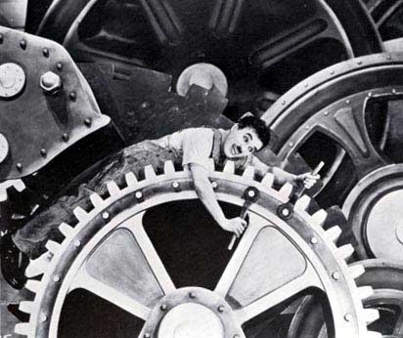
Defining Technology
Technē:
+
Logos:

Slide 4

Thinking About Technology
1. Instrumentalist View:
Technologies are neutral
Technological outcomes depend on how artifact is used by humans
Focus on efficiency and effectiveness
Technological progress unquestionably positive

Slide 5

Thinking About Technology
2. Technological Determinism:
Technology operates according to an inherent, internal logic
Technological outcomes depend imposed by technology itself
Technology as external force (i.e. autonomous)

Slide 6

Thinking About Technology
3. Substantivist View:
Technologies embody specific values
We make things with technological instruments but technologies also make something of us
Technological progress often negative

Slide 7

Thinking About Technology
4. Social Constructivist View:
Technology is not an autonomous force
Technologies constructed via interactions between artifact and social context in which it is situated
Efficiency/Effectiveness does not necessarily impose specific outcomes

Slide 8
What determines technological outcomes?
Technological determinism:
Technical properties of artifacts determines social/economic/political impact (i.e. technology as an autonomous force)
Technical properties impose particular outcomes
Social constructivism:
Technical properties are the outcome of conflicting interests and ideas
Multiple outcomes possible

Slide 9

Technology and Society
What determines technological outcomes?
Design of technology
Situation/context of artifact
How technology is actually used
intended vs. unintended uses

Slide 10
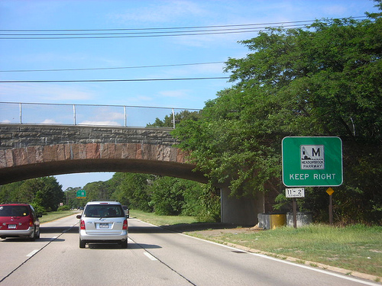
Long Island Expressway to Jones Beach

Slide 11

The Internet
Roots in the Cold War
Originated from 1969 ARPANET US government defense project
Developed as non-centralzed peer-to-peer system
End-to-End Design
Net Neutrality

Slide 12
Structure of the Internet
Key Feature = Internet consists of ‘4 layers’
1. Content/Transaction Layer
Info available on or over the Internet, including Web sites (i.e. email, music files, video streams, & transactions).
2. Application Layer
Hardware & software (i.e. email, Web browsers, html)
3. Logical Infrastructure Layer
‘Glue’ that ties all 4 layers together (i.e. communication protocols – TCP/IP; domain names etc)
4. Physical Infrastructure Layer
telephone & cable TV access lines, network lines
Notes:
12

Slide 13
